Slide 1
Message Broker to the Rescue
Michael Alberhasky
ITS-AIS

Slide 2
Dispatch Background
Originally built in 2012
Communication engine that can:
  Send email
  Generate PDFs
  Send SMS messages
  Place voice calls
Uses institutional data to derive populations
Full API for application integrations

Slide 3
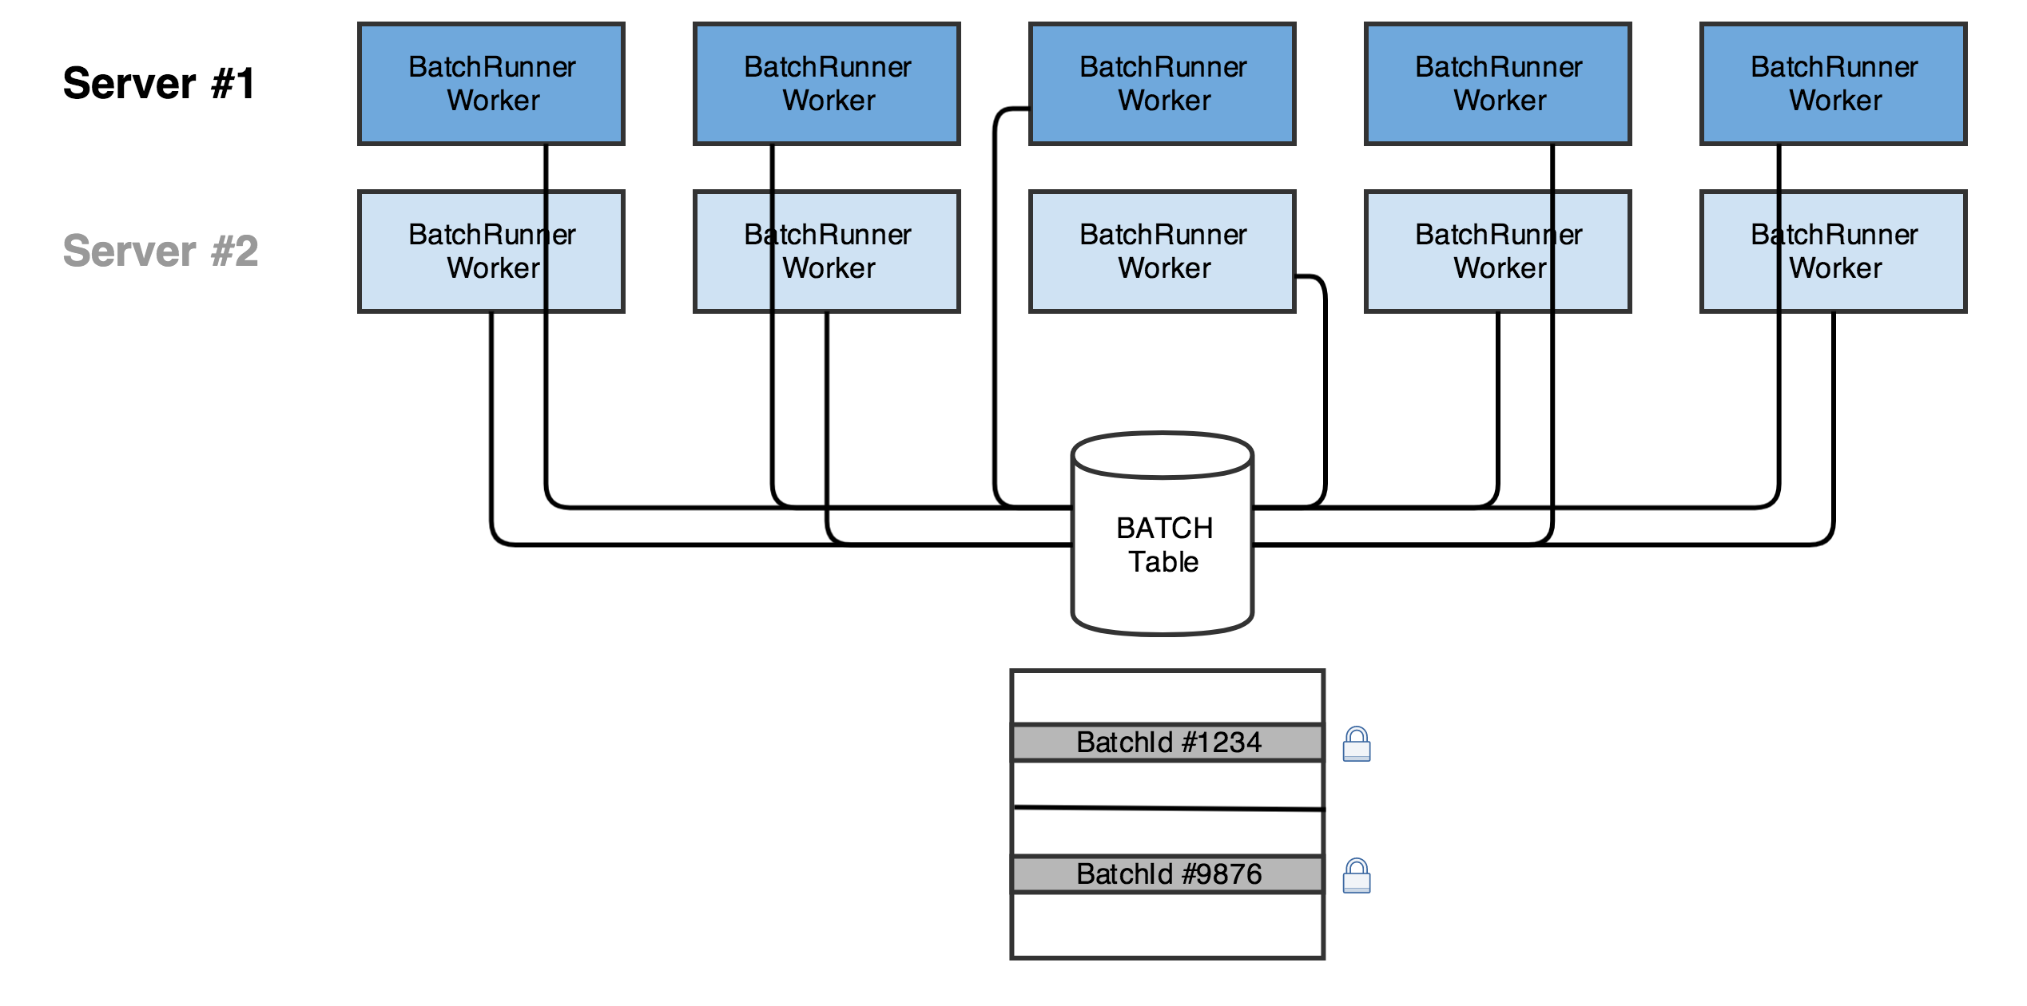
Original Batch Processing

Slide 4
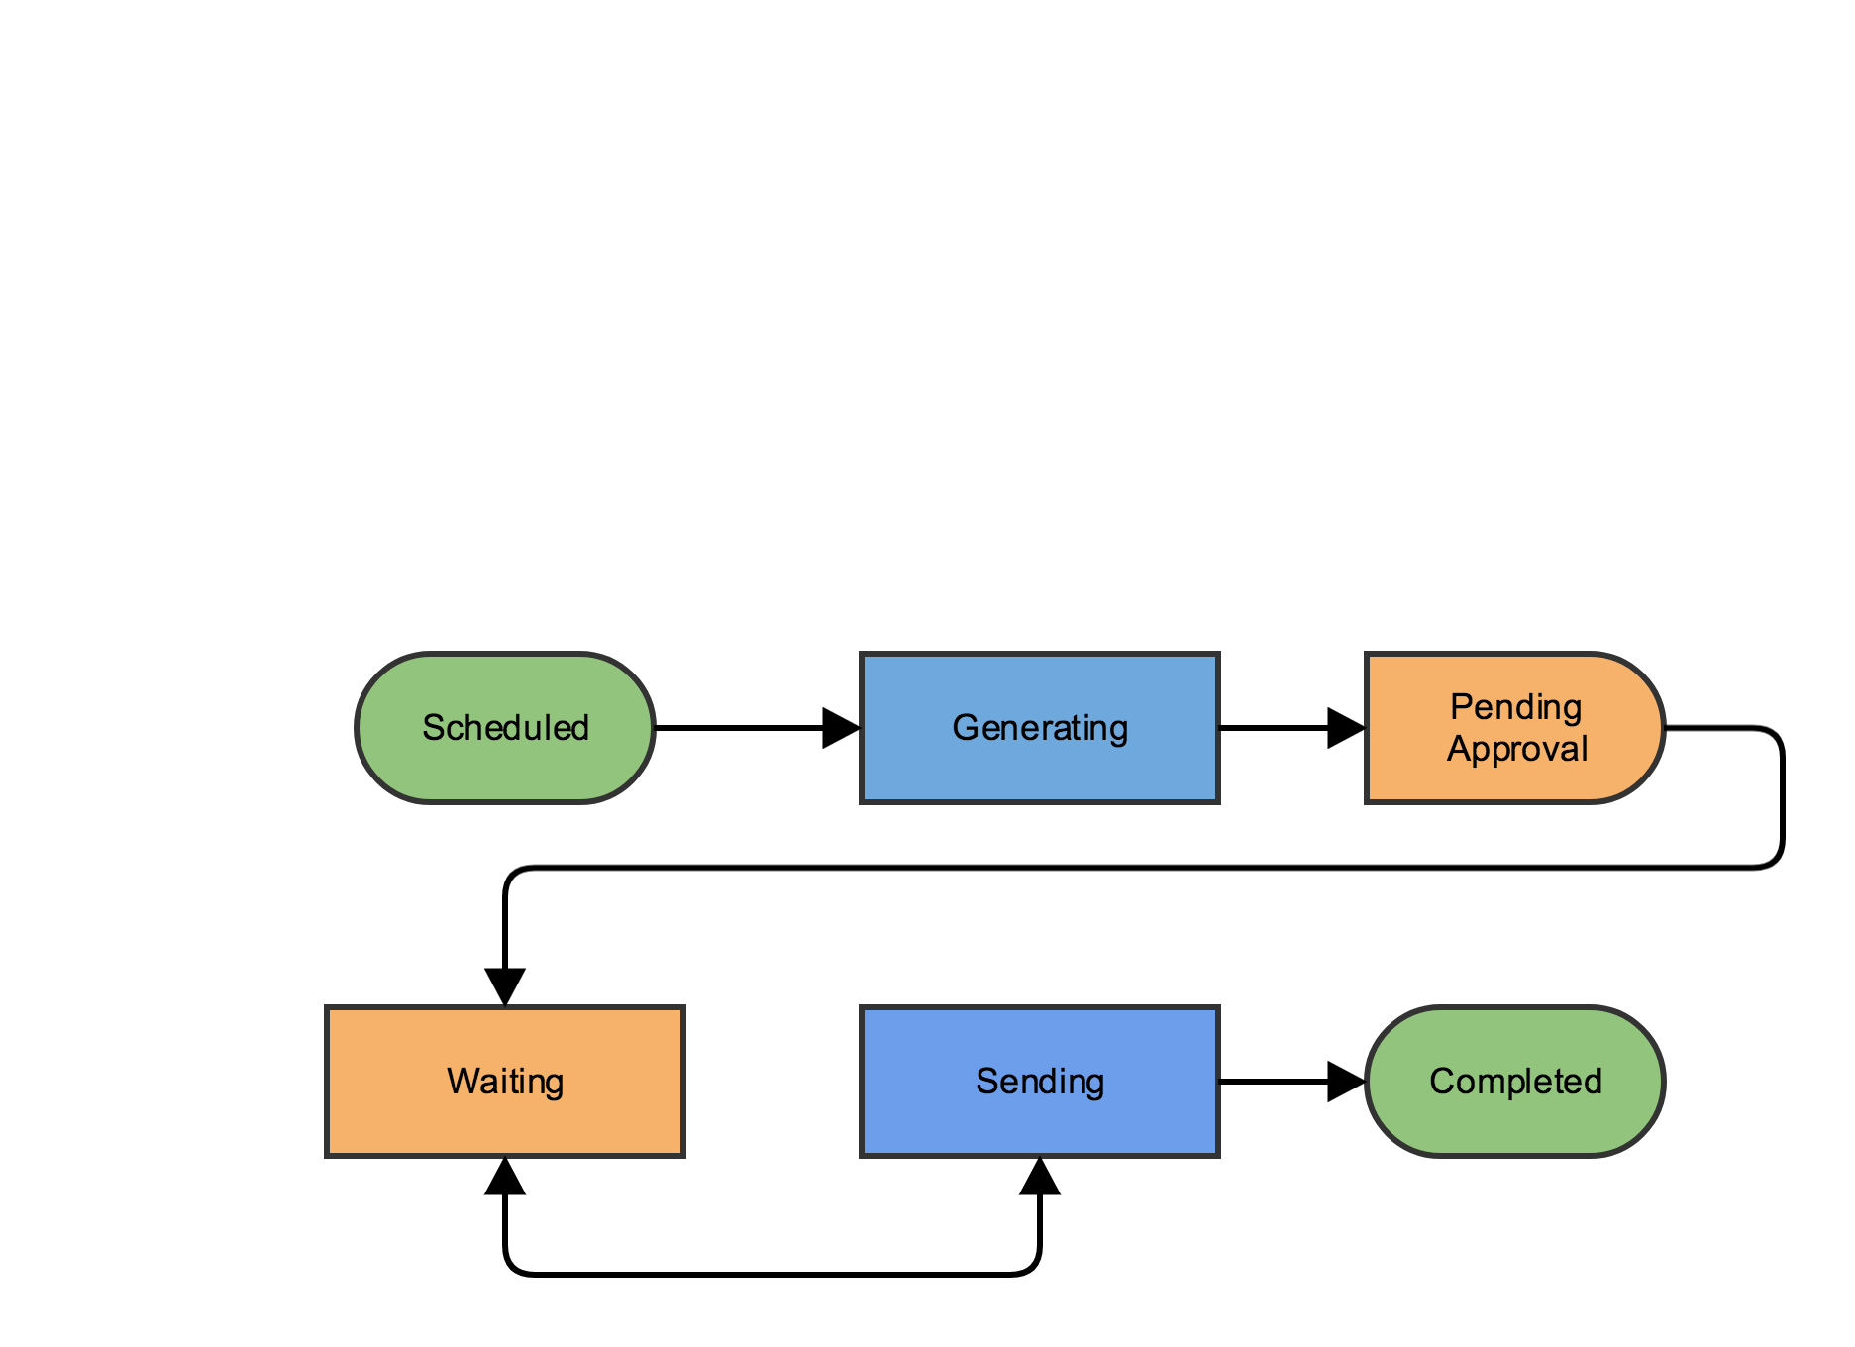
Original Batch Workflow

Slide 5
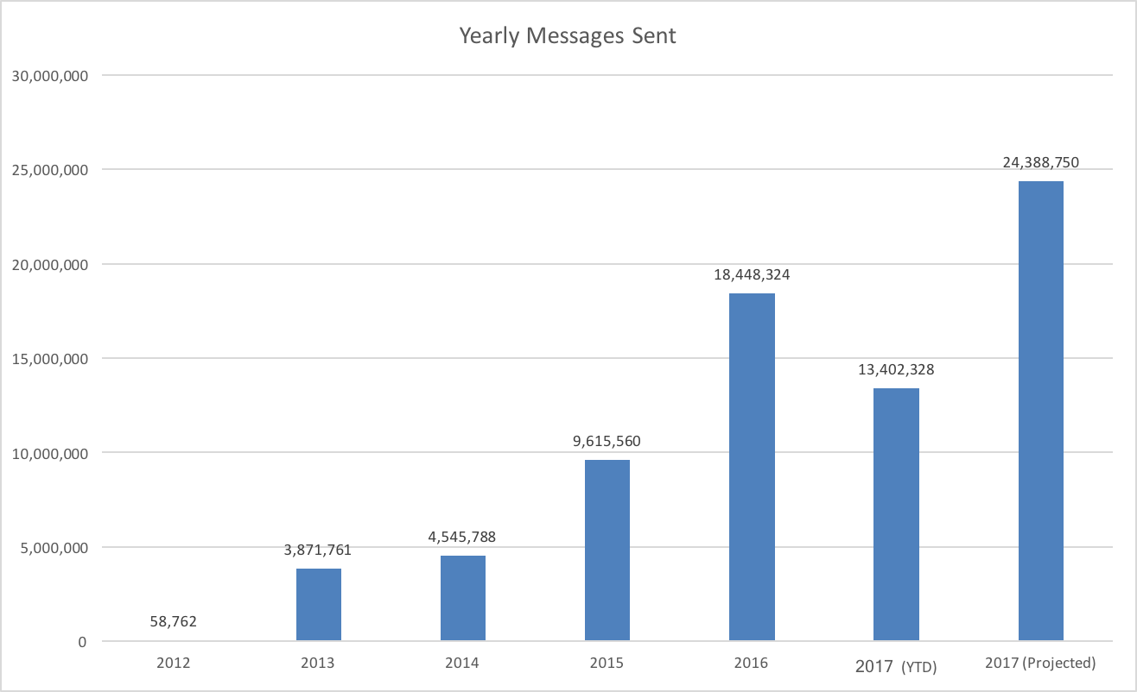
Growing pains

Slide 6
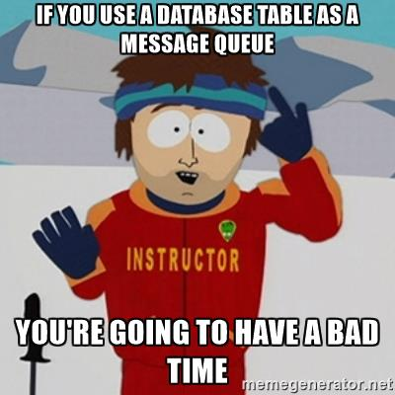
February 9, 2017
The Day Dispatch Stood Still
Water quality alert: 52,000 messages
190,000 Admissions messages spread over 9 batches
3,700 other batches
257,000 messages for the whole day

Slide 7



Time for a message broker. So many choices…

Slide 8
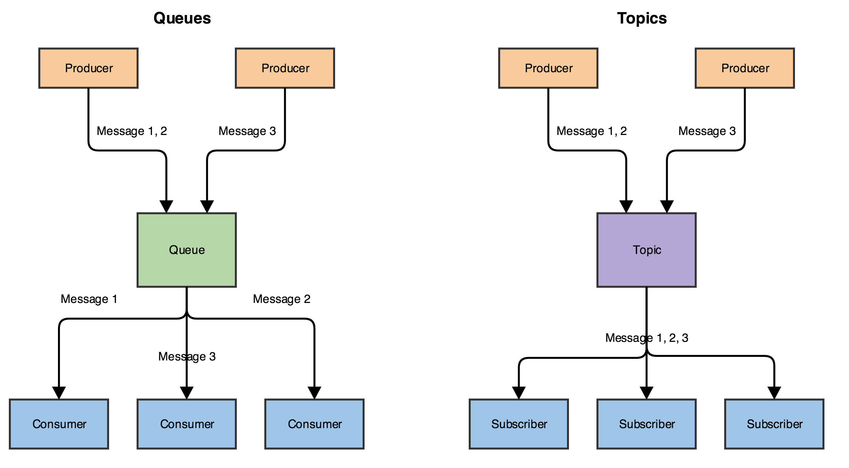
Queues and Topics

Slide 9
Migrated in stages
Convert callback runner to message broker
Extract message generation phase out from batch runner
Migrate from batch runner to multi-threaded send workers for different priority messages
  Bulk – For marketing messages
  Dedicated - For clients that need highest priority
  Print – For using server with CUPS print queue
  Trickle – For clients that aren’t playing by the rules
  Normal – For regular priority

Slide 10
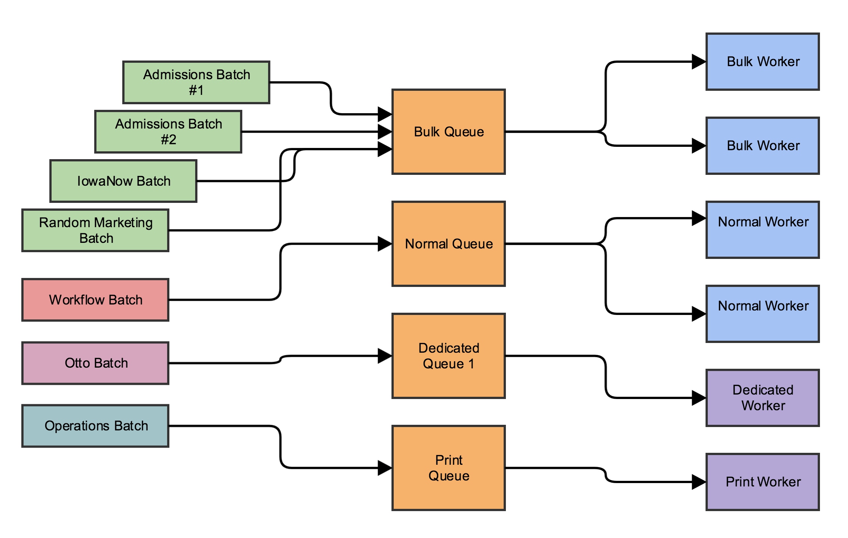
Hypothetical Queue Layout

Slide 11
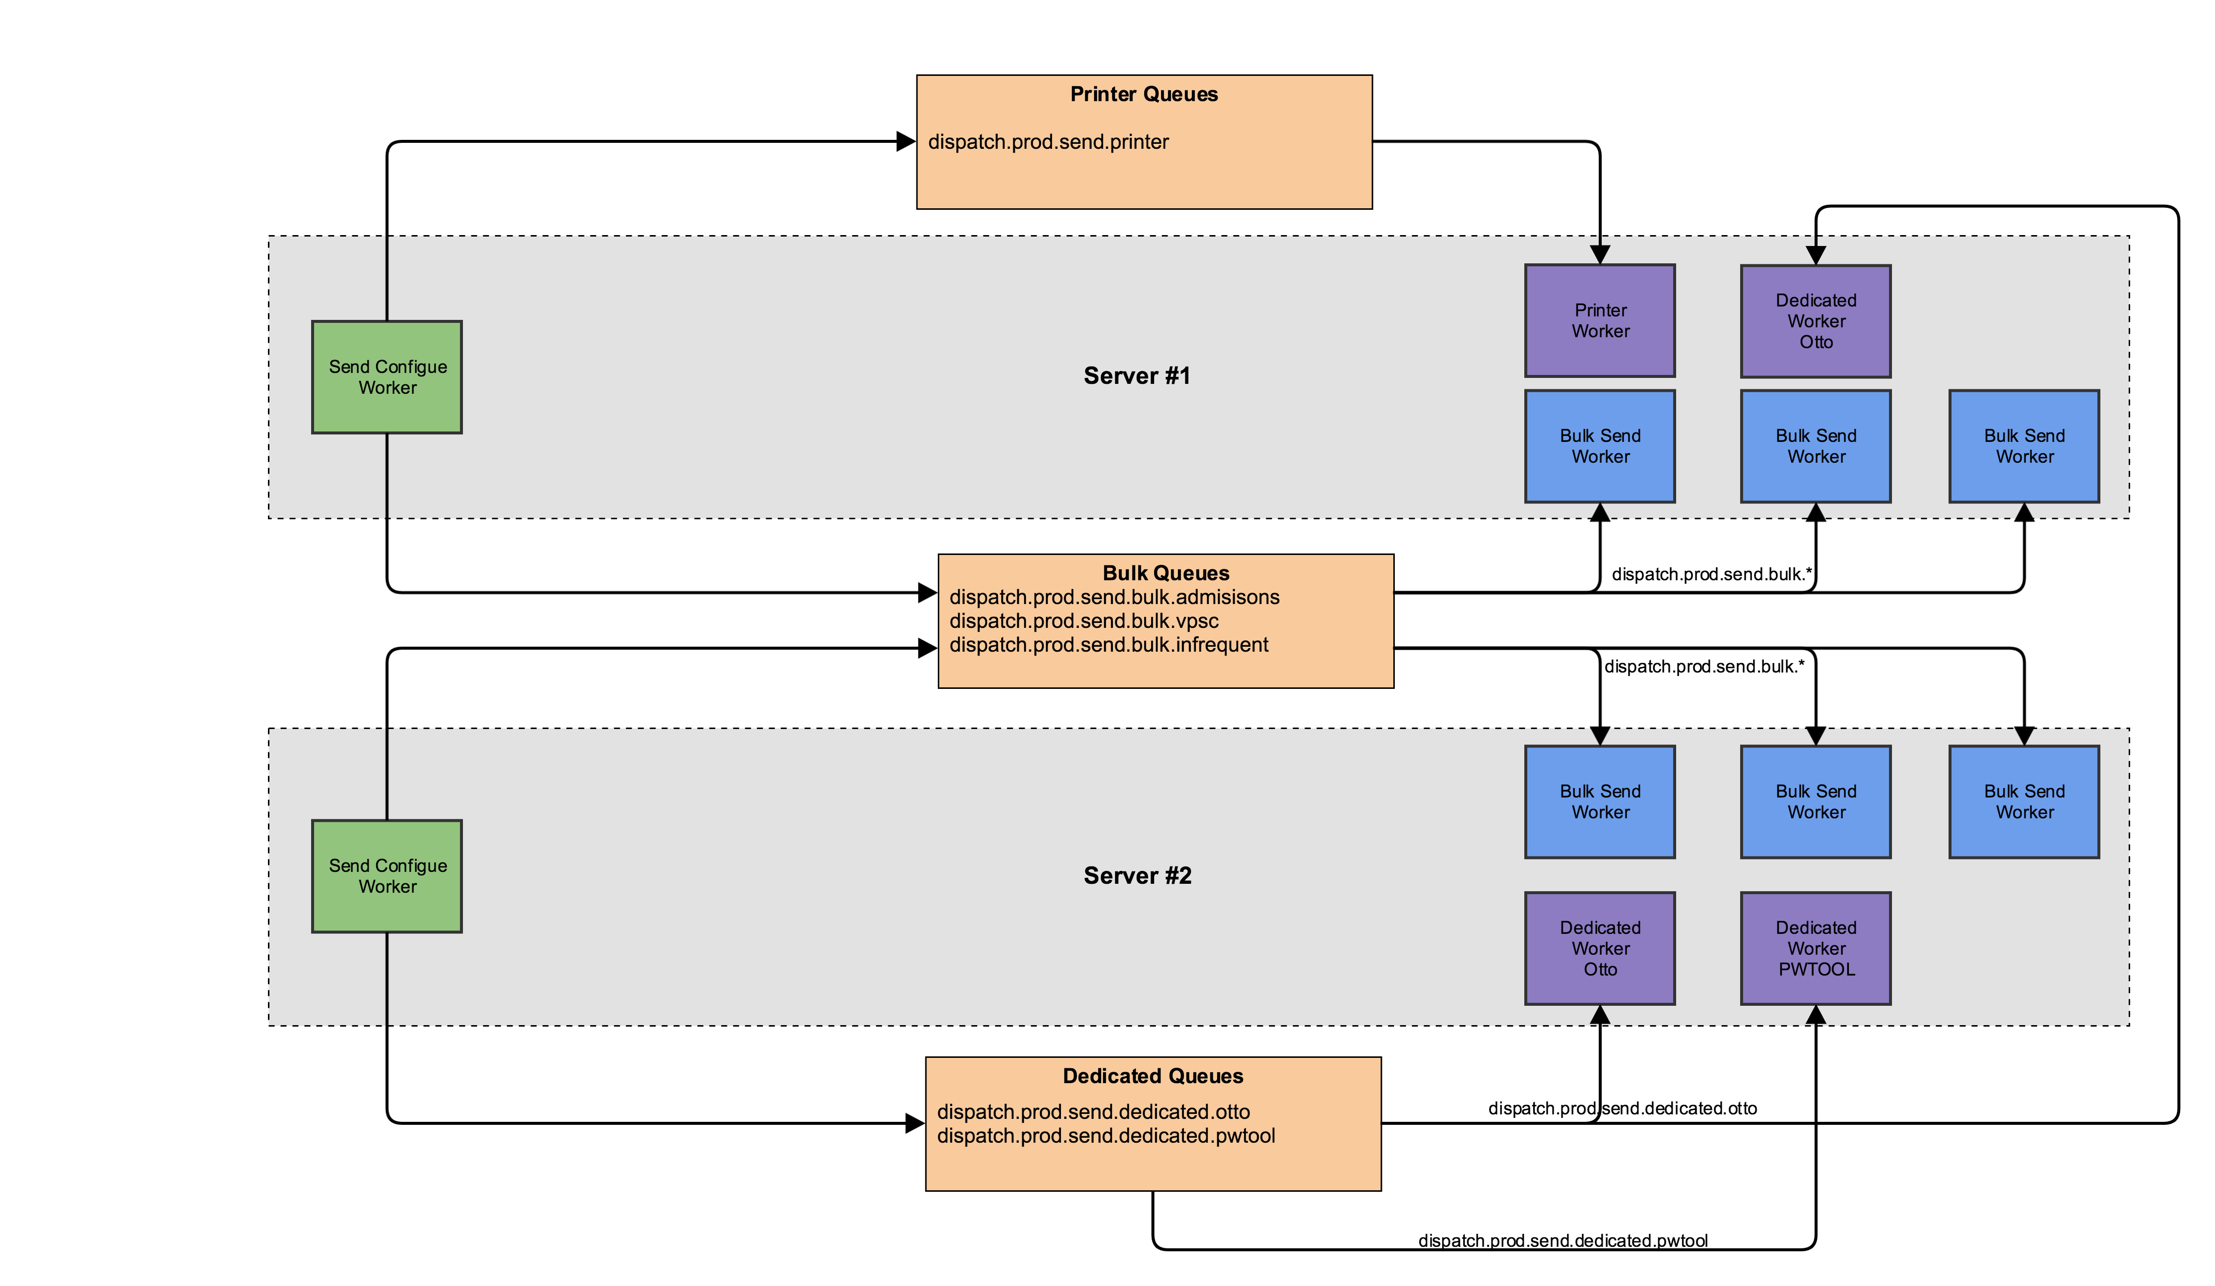
Worker/Queue Layout

Slide 12
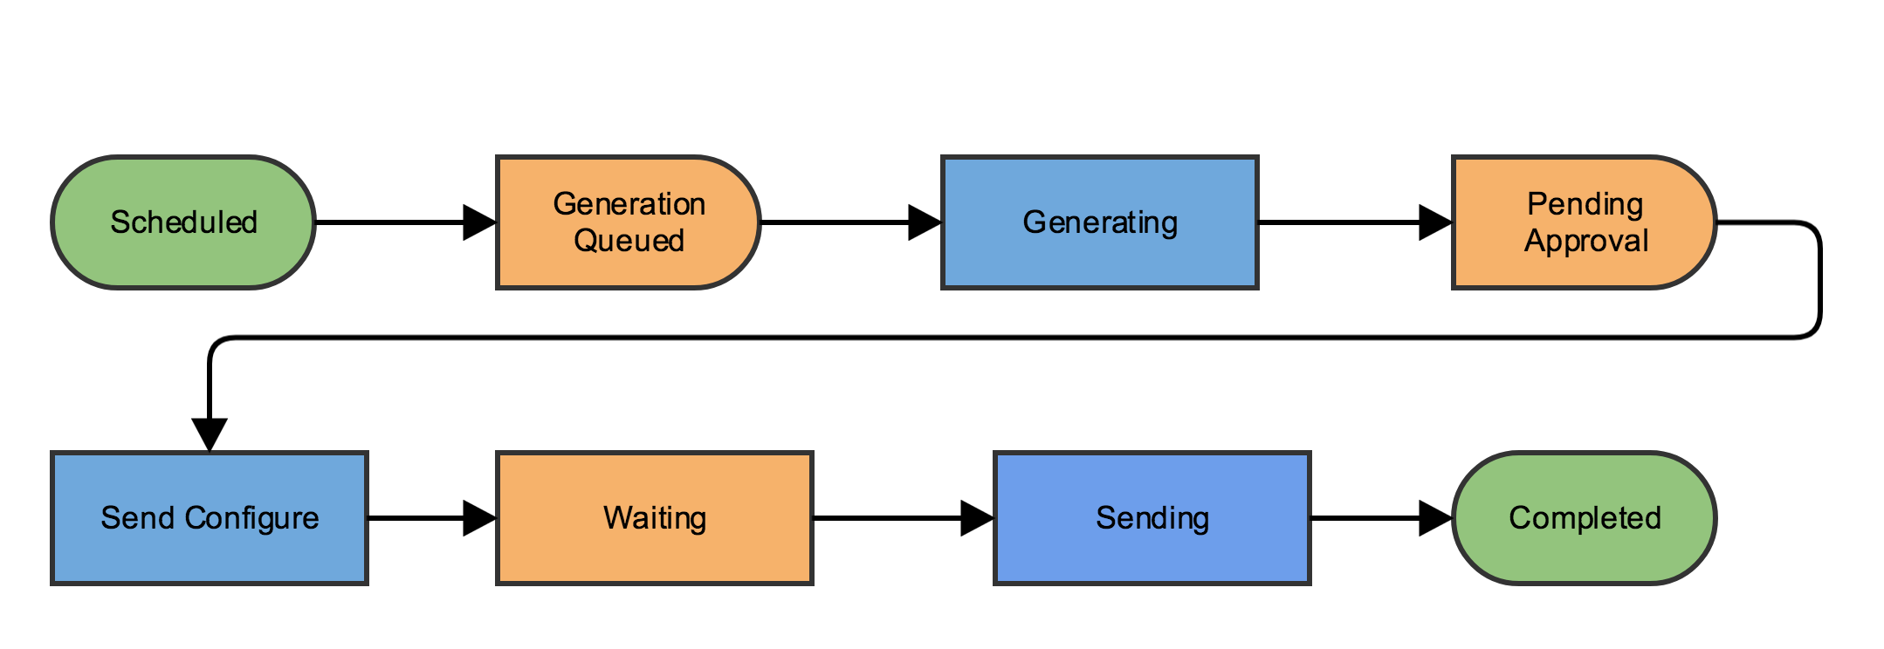
New Batch Workflow

Slide 13
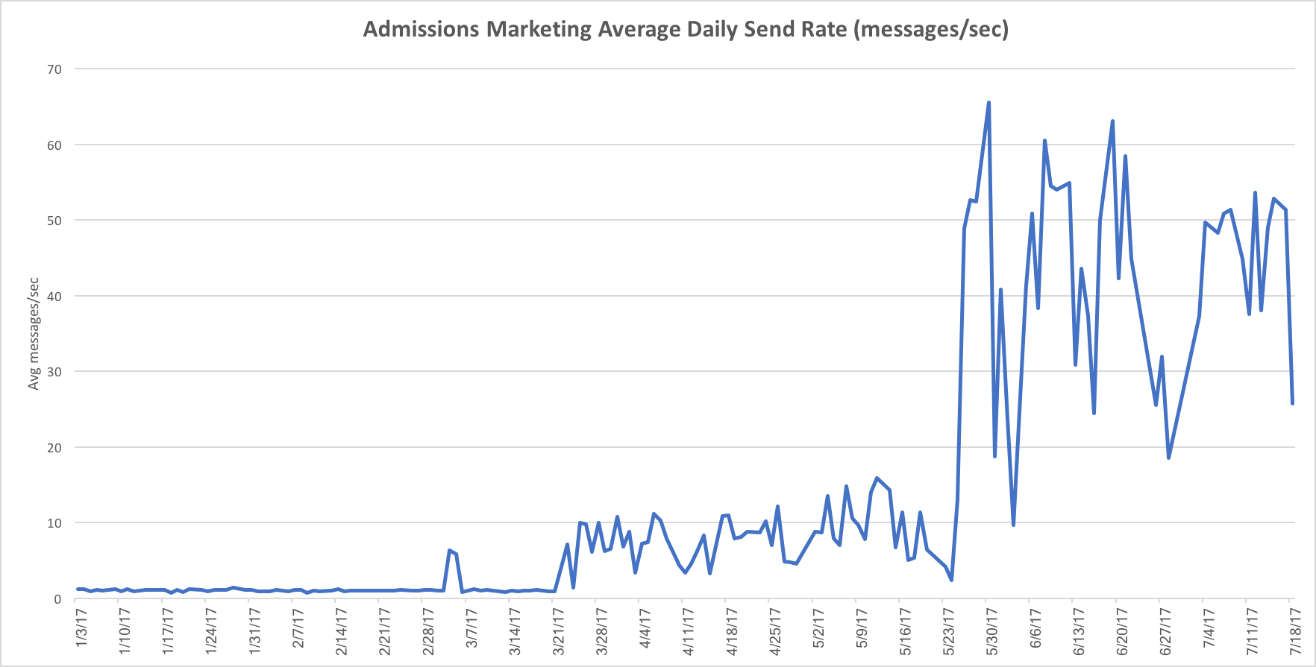
Send Rates
Notes:
January 2017: 1.1 messages/sec
April 2017: 7.5 message/sec (just using message queue)
July 2017: 45 messages/sec = 4100% improvement

Slide 14
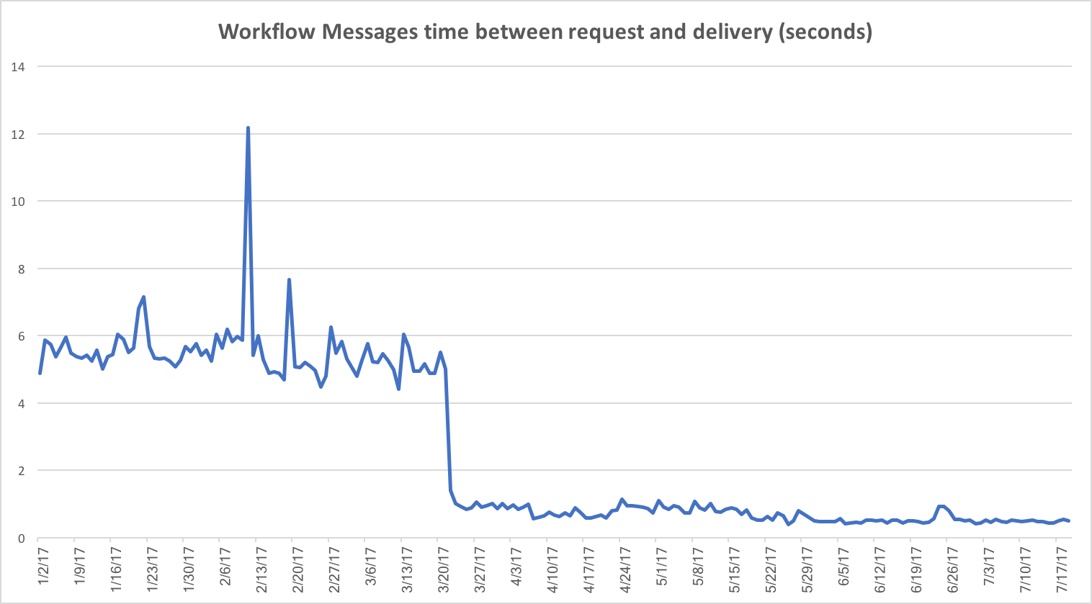
Time to Deliver
Notes:
January 2017: 5.5 seconds
July 2017: 0.48 seconds = 1100% improvement

Slide 15
Next steps
Move to RabbitMQ?
Make message generation truly multithreaded
Offload some DB operations to MQ

Slide 16
Questions?
Michael Alberhasky
ITS-AIS
michael-alberhasky@uiowa.edu

